Slide 1
Diffusion Models for Expressive Manipulators

Slide 2
agenda
Expressive Manipulators
Open-Source Diffusion Models
Open-Source Datasets
Frameworks
Proposal

Slide 3
Expressive Manipulators

Slide 4
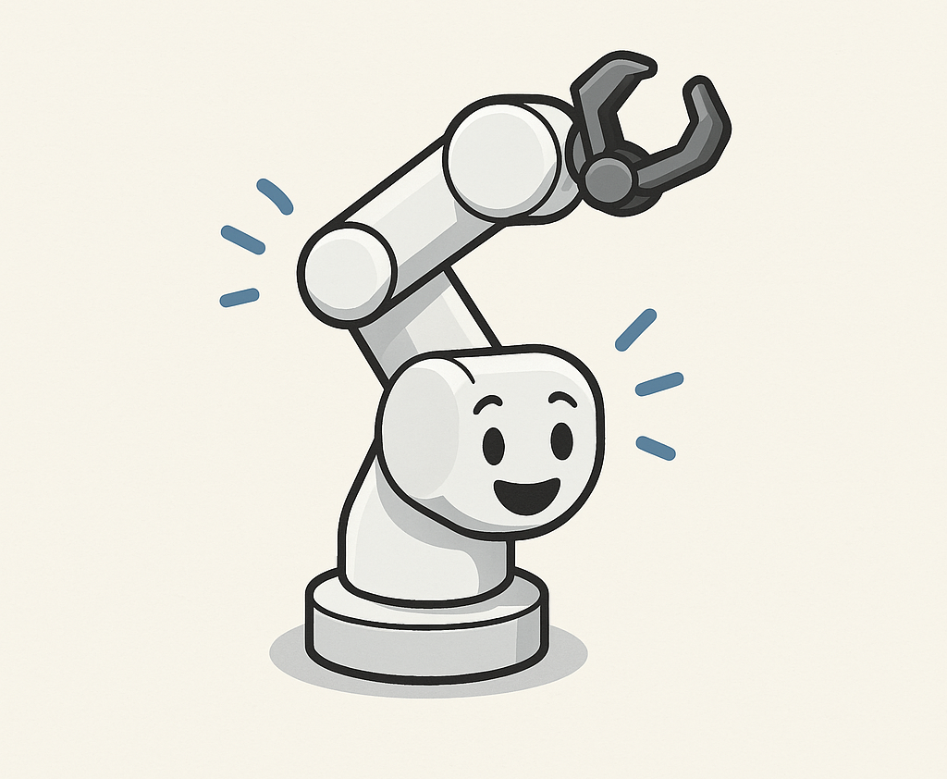
Expressive Manipulators
Robotic arms that convey emotion, intent, or social cues through movement.
Go beyond task execution to enhance human-robot interaction (HRI).

Slide 5
Open-Source Diffusion Models

Slide 6
Robotic Diffusion Transformer (RDT-1B)
Model Type | Diffusion Transformer
Parameters | ~1.2 Billion
Training Dataset | Open X-Embodiment (1M+ trajectories, 22 robot types, 527 skills)
Input Modalities | RGB Video, Language Instructions, Proprioception
Output | Unified action space: joint positions, velocities, gripper control
Conditioning | Text + Visual context
Generalization | Zero-shot across unseen objects, tasks, and robots
Embodiments Supported | Single-arm, Dual-arm, Mobile base + manipulator
Repositories | https://github.com/thu-ml/RoboticsDiffusionTransformer

Slide 7
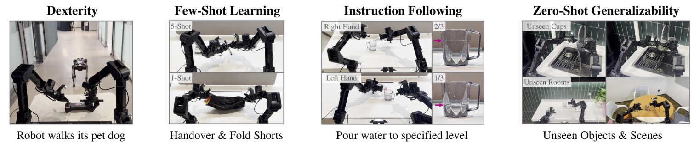
RDT-1B - Advantages
General-purpose robotic manipulation
Zero-shot skill transfer
Language-conditioned action generation
Can be fine-tuned for emotion-based or stylistic behavior with labeled data.

Slide 8
RDT-1B - Challenges
Not trained on expressive/emotional datasets
Requires GPU resources for training or fine-tuning.
Fine-tuning for expression demands a custom labeled dataset.

Slide 9
Diffusion Policy: Visuomotor Learning via Action Diffusion
Model Type | Denoising Diffusion Probabilistic Model (DDPM) for action generation
Training Method | Behavior Cloning on human demonstrations
Input Modalities | RGB images (observation), task context (goal image, language, etc.)
Output | Full trajectory (joint actions or end-effector poses)
Action Representation | High-dimensional, continuous; allows multi-step planning
Repositories | real-stanford/diffusion_policy

Slide 10
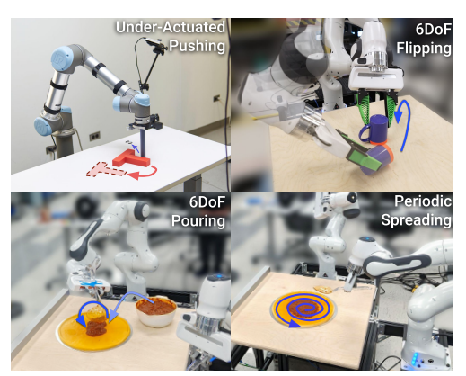
Diffusion Policy - Advantages
Multi-modal action distributions
Generates diverse trajectories from the same visual input
Trajectory-level control (speed, style, or intent)
Adaptable for style-conditioned or emotion-conditioned generation.

Slide 11
Diffusion Policy - Challenges
Requires labeled demonstrations to train
Trained on task-oriented, not expressive data, needs custom labeling or stylization.
Sampling can be computationally expensive (slower than one-shot policies).

Slide 12
Which Diffusion Model for Expressive Manipulators ?

Slide 13
Diffusion Policy
Faster prototyping
Easier fine-tuning with expressive labels
Better control over trajectory sampling
Less resource demand

Slide 14
Open-Source Datasets

Slide 15
Open X-Embodiment Dataset Foundation for Generalist Robots
Size | Over 1 million robot trajectories
Sources | Aggregated from 60+ robot datasets across 22 institutions
Robot Embodiments | 22+ types: single-arm, dual-arm, mobile arms
Tasks & Skills | 527 unique skills: open drawer, pick up, push object, etc.
Modalities Included | RGB video, proprioception, joint states, gripper actions, language goals
Repositories | robotics-transformer-x.github.io

Slide 16



Open X-Embodiment Dataset – Expressive Manipulation
Used to pretrain functional models
Need stylization layers or synthetic emotion labels
Need fine-tuning with small expressive demo dataset

Slide 17
DROID (Distributed Robot Interaction Dataset) Diverse Multi-Scene Robot Demonstrations
Size | 76,000+ demonstration trajectories
Robot Embodiments | Mostly single-arm manipulation setups
Tasks & Scenes | 86 unique tasks across 564 real-world scenes
Modalities Included | RGB video, depth, proprioception, natural language instructions
Annotation Type | Task goal descriptions (natural language)
Repositories | droid-dataset.github.io

Slide 18
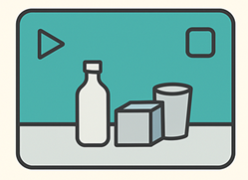

DROID – Expressive Manipulation
Used to pretrain visuomotor policies (e.g., Diffusion Policy)
Useful for learning scene-aware manipulation grounding
Supports text conditioning, enabling future emotion-style injection
Needs post-hoc stylization or fine-tuning for emotional expression

Slide 19
Frameworks

Slide 20
Laban-Based Controlling Modeling Expressive Motion Through Human Movement Theory
Core Components | Effort (dynamics), Shape, Space, Body
Application | Mapping human expressive motion descriptors to robot joint trajectories
Control Strategy | Trajectory modulation using Laban qualities (e.g., weight, time, space)
Modalities Included | RGB video, depth, proprioception, natural language instructions
Dataset? | No, rule-based or style-conditioned

Slide 21
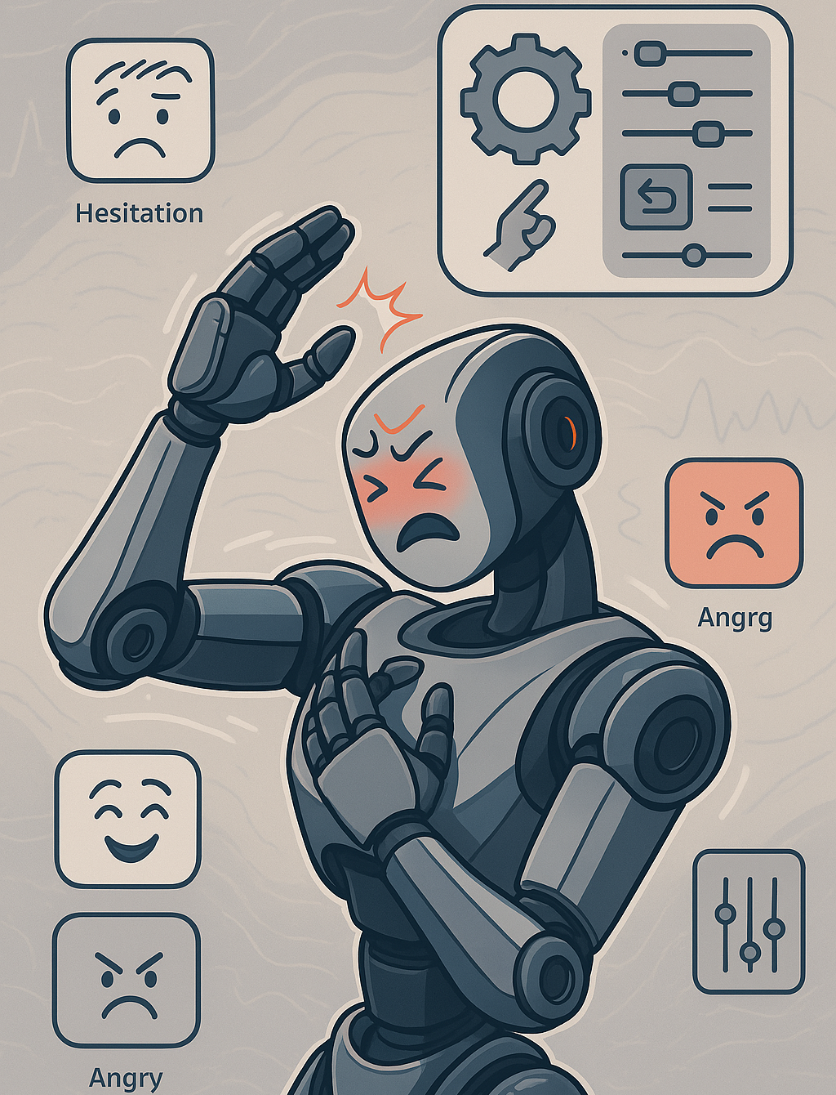
Laban-Based Controlling – Expressive Manipulation
Offers gesture stylization over task-agnostic or functional motion
Overlays expressive qualities like hesitation, anger, joy
Control module or motion filter on top of diffusion policies
Not a standalone policy for task success or planning

Slide 22
Dynamic Movement Primitives (DMPs) Learning & Modulating Motion for Expressive Control
Core Components | Time, speed, goal, amplitude, and shape
Application | Encodes motion as a nonlinear system with a learnable forcing term
Control Strategy | Modulated trajectories (joint or Cartesian space)
Modalities Included | Demonstrated trajectories
Emotion Encoding? | Yes (via modulating DMP parameters: gain, damping, duration)

Slide 23
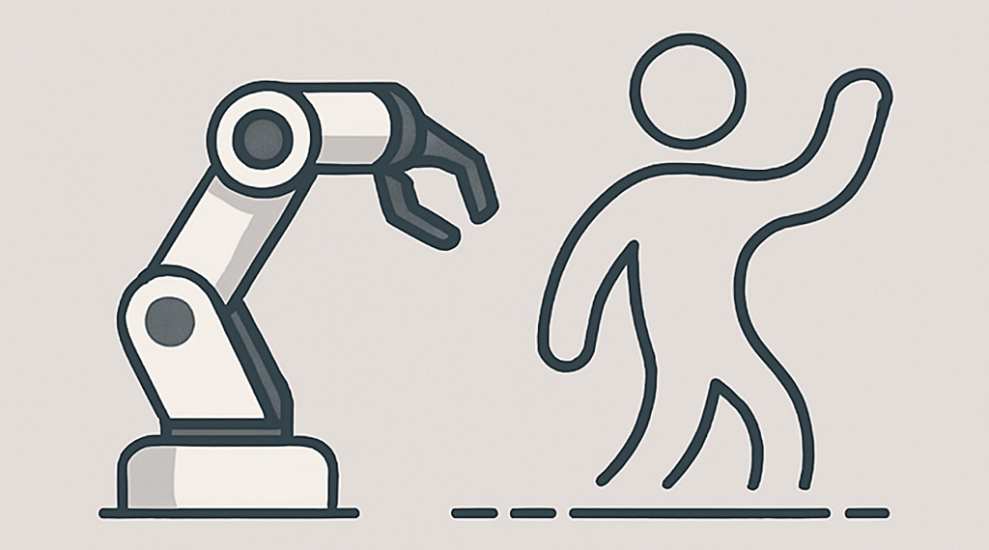
DMPs – Expressive Manipulation
Emotion-conditioned movement modulation (e.g., scaling time, force).
Integrates with other planners (e.g., combine with Laban, diffusion models).
Not a full policy, best used as a motion execution or stylization layer.

Slide 24
Proposal
For expressive manipulators

Slide 25

Diffusion Model for Expressive Manipulators
Use Diffusion Policy as Base
1
Create Stylized Demos with Emotion Modifiers
2
Add Emotion Labels to Data
3
Fine-Tune the Model with Expressive Demos
4
Sample Emotional Motions and Visualize
5

Slide 26
Thank You

